Slide 1
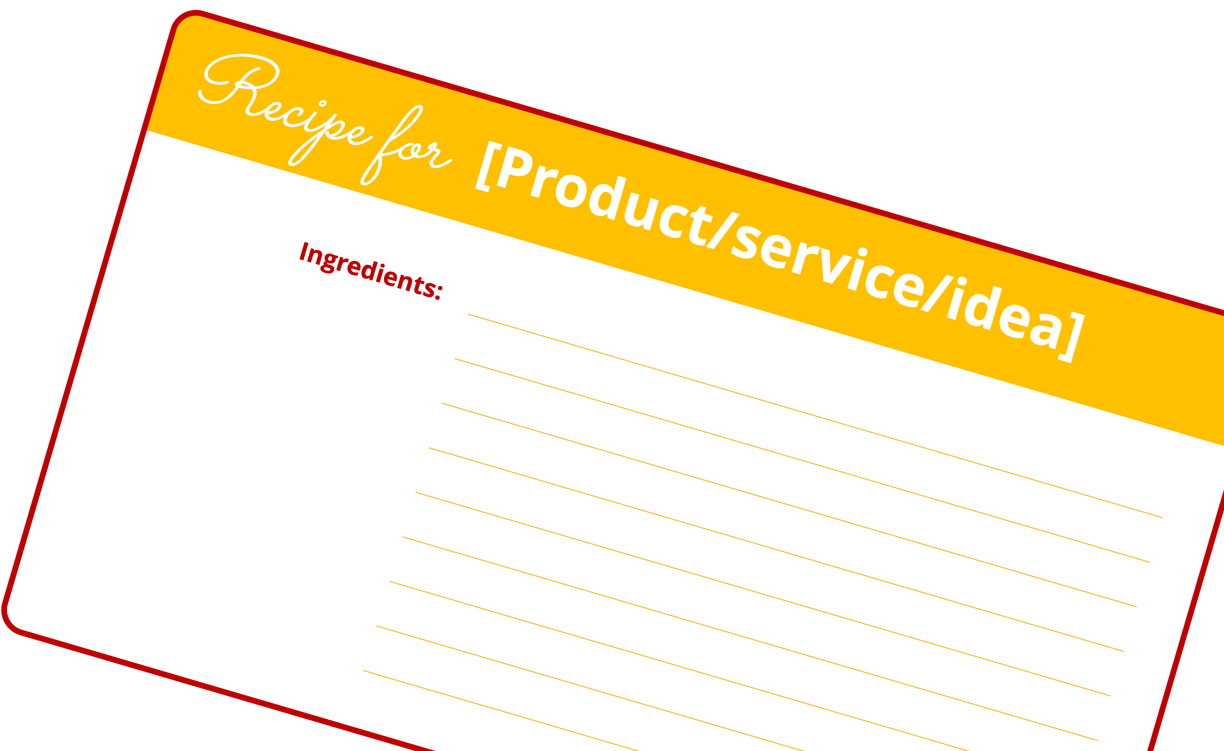
Grids & Recipe Card Template
A companion resource for the handout from the QRCA 2023 Annual Conference session titled
“Designing reports that will engage – not overwhelm –
the senses”
Created & presented by
Maria Virobik | ResearchScribe
maria@researchscribe.com
© 2024 Maria Virobik

Slide 2
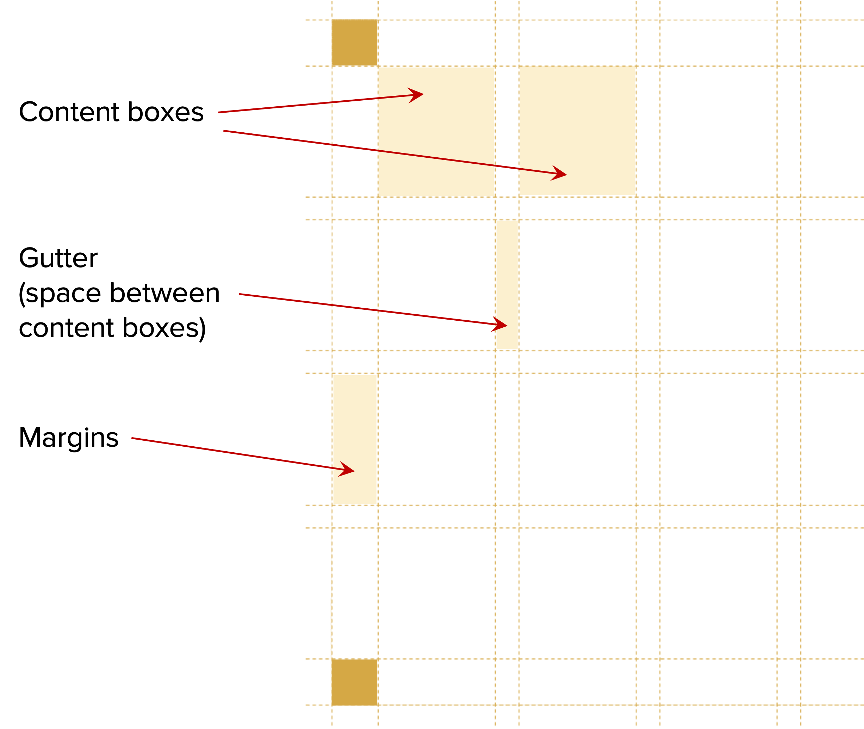
Grids
The grids on the next two pages are transparent PNG images that you can cut and paste into your document to guide your slide layouts.
Once you cut and paste the grid into your PPT, resize so the shaded boxes in each corner align with the corners of your slide.
If you prefer to use PowerPoint’s built-in guides, you can use these grids to help you determine where to place the horizontal and vertical lines.
Anatomy of a grid
© 2024 Maria Virobik

Slide 3
12-column grid for letter-sized slides
© 2024 Maria Virobik

Slide 4
12-column grid for widescreen slides
© 2024 Maria Virobik

Slide 5
Recipe card template
All text can be resized and fonts and colors can be changed.
This template uses Sacramento and Open Sans fonts. Both are available for free at fonts.google.com.
Change the card outline, header and fill colors to match your desired color palette.
See the next page for an example.
Recipe for [Product/service/idea]
Ingredients:
[Insert text]
[Insert text]
Add a picture here
[Insert text]
[Insert text]
[Insert text]
[Insert text]
[Insert text]
[Insert text]
[Insert text]
© 2024 Maria Virobik

Slide 6
Recipe for The “Ideal” Snack
Ingredients:
All-natural
Fresh, locally-sourced organic fruits and vegetables
Low in fat
Low in carbohydrates
Fortified with necessary vitamins and minerals
Added fiber
Max 10-12 grams of sugar
100 calories or less
20-25 grams of protein
© 2024 Maria Virobik

